Slide 1


Chatbot for Excel Data
Analysis
This Natural Language Excel Chatbot is a web based assistant which is designed using the gemini model and streamlit.
This chatbot is powered by Gemini API and capable of interpreting natural language queries , analyzing excel datasets and present results in the form of text,chart,code and tables.

Slide 2


Project Overview
Title: Excel Chatbot using Gemini and Streamlit
2. Objective: Build an interactive chatbot to analyze
Excel datasets using natural language and Streamlit
3 .Tech Stack: 1. Gemini,
2.Streamlit UI,
3.Pandas and Python

Slide 3



The Data Analysis
Features
Upload any excel file
2. Show a sample dataset of 10 rows of data
3. .Ask any Natural Language Question like:
a. How many people are younger than 54 .
b. Design a Table for any number of features
4 Outputs
a. summerized Insights.
b. Tables Generated through pandas.
c. Matplotlib Visualizations

Slide 4

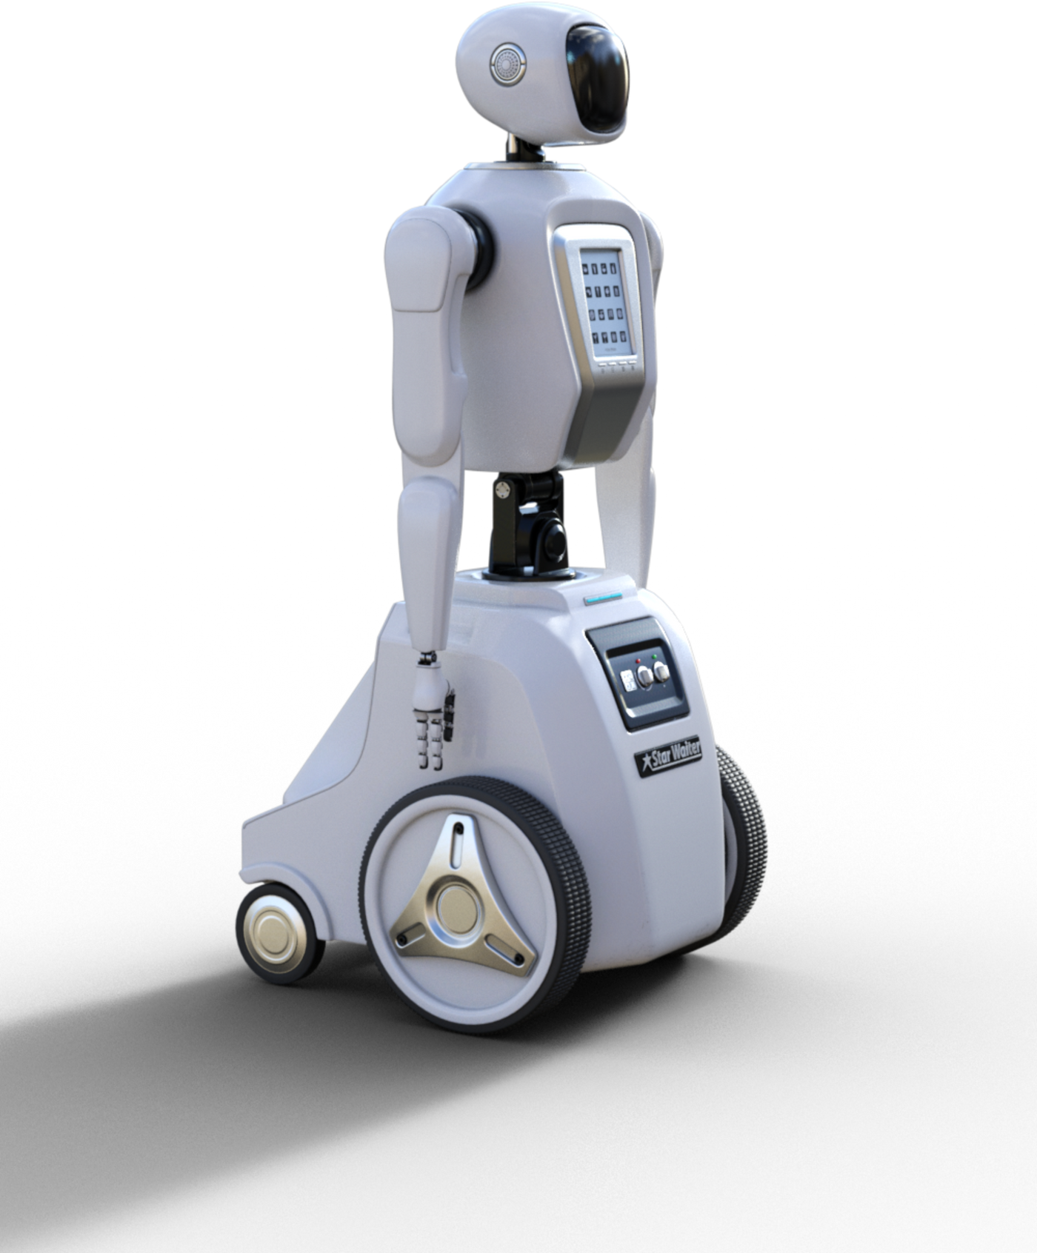

DESIGN STRUCTURE
1.User Interface: Streamlit Web App
2.Backend:
3.Use gemini model(gemini-1.5-latest-flash)
to generate the results and code
4.Code is executed securely
5.Output shown : Text , Code, Charts, Tables

Slide 5


Flow Diagram
1.User upload the Excel file on streamlit web app
2.User enter the question to get results in text and code format
3.Gemini generate the code using gemini-1.5latest-flash model
4.Streamlit Web App executes code try to get the results.
5.Output shown as the text/code/plots/tables.

Slide 6


Page 07
Prompt Design
You are a great data Scientist. You are going to help me in analyzing the dataset that I provided to you in the tabular format.If the question
implies a trend, comparison, or distribuƟon, generate appropriate charts (e.g. bar chart, histograms, line chart). Ensure the charts are readable and labelled clearly

Slide 7
Page 05
Sample Output
Query: How many persons of age above 25?
2. Generated Code: count = df[df['age'] > 25].shape[0]
print("Number of persons with age above 25:", count)
3. Output: Number of persons with age above 25: 42

Slide 8



Challenges
1.Gemini sometimes hallucinates answers
2.Need to restrict LLM to code generation only
3.Must sanitize inputs and outputs

Slide 9

Add support for Follow up
question (contextual memory)
01
Can be done using PromptTemplate and Output parser to get better results and standard format
02
Use LLM’s chains to improve
code efficiency.
Our Future work
03
04

Slide 10




CONCLUSION
A working chatbot that turns Excel data into actionable insights
Combines LLM reasoning + Python execution Easy
for non-programmers to use

Slide 11

THANK YOU

